Slide 1

Emirates Group Metaverse
Coforge Proposal
30th December 2022

Slide 2
Agenda
Executive Summary
Management Profile
Proposed Solution
Requirement Response
Project Management
Assumption & Dependencies
Training
Appendix B (Sub-Contractor Profile)
Appendix (About Coforge)
01.
02.
03.
04.
05.
06.
07.
08.
09.

Slide 3
Executive Summary (Ratan/Harish)

Slide 4





Coforge has been Emirates’ Trusted Partner for more than 15 years
Emirates – dnata Engagement
KEY SERVICES
90+
Team in EK-WMAP
85+
Team in dnata CGS and Leisure
5000 circa
Story Points Delivered
Development
Services
Application Management
Weblogic, TIBCO, iOS, ELM
15+ Domains
IBE, Ancillaries, Payments, RESCONNECT, EBC, CGS, Agent, EKH, TR, HC,Web
15+
Technologies and Niche Skill combinations supported
150+
Agile Practitioners
Cyber Security
Services
Professional
Services
Engagement Journey
2006: Started engagement with Emirates.com development
2017: CyberSec engagement in SLA driven model, 5 years contract which got renewed
Ongoing Professional Services work through PONTOON
2021: EK WMAP and dnata
Setup & PoC
PoC Team setup and contract award
Infra/ Network Setup
Full team SAFe certified
CGS transition - 3 sites to single location-2 teams
Now
April ‘21
Aug’21
Delivery @ SCALE
Alignment with TTH
Team back in office
Revamped Selection process
June’21
Full & Hybrid Teams
Groups sites, Payments, MWEB, EBC Excess Baggage
AAT11: RESCONNECT
Dec’21
Travel Republic and EK Holidays initiated
Feb’22
One AIR, Agile Process @CGS
QA Automation for CGS
Mar’22
HoneyComb Web followed by HC Agent in April
Improvement Plan
Beyond
Stepping up the value chain
80% Automation coverage
Continuous Service Improvement

Slide 5
Agenda
Executive Summary
Management Profile
Proposed Solution
Requirement Response
Project Management
Assumption & Dependencies
Training
Appendix B (Sub-Contractor Profile)
Appendix (About Coforge)
01.
02.
03.
04.
05.
06.
07.
08.
09.

Slide 6


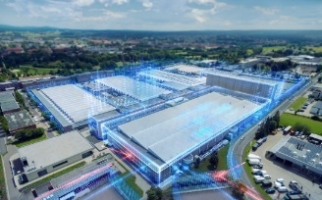
























$866m FY22 Revenue |  |  | 250+ Clients
64.5% Fy22 Revenue from Digital, Product Eng., Data, Cloud-Infra |  |  | ~22,740 Employees globally
26 Delivery centers 17 Nearshore centers |  |  | 12+ years Average tenure of top 10 customers
STRONG VERTICAL FOCUS ACROSS GEOGRAPHIES…
Vertical Split |  | Geographical Split
Specialized in select industries
Differentiated platform & product engineering
Driving adoption of Cognitive, Automation, Integration, Data & Cloud
Exceptional client focus & loyalty
LASTING RELATIONSHIPS
KEY PARTNERSHIPS

Slide 7
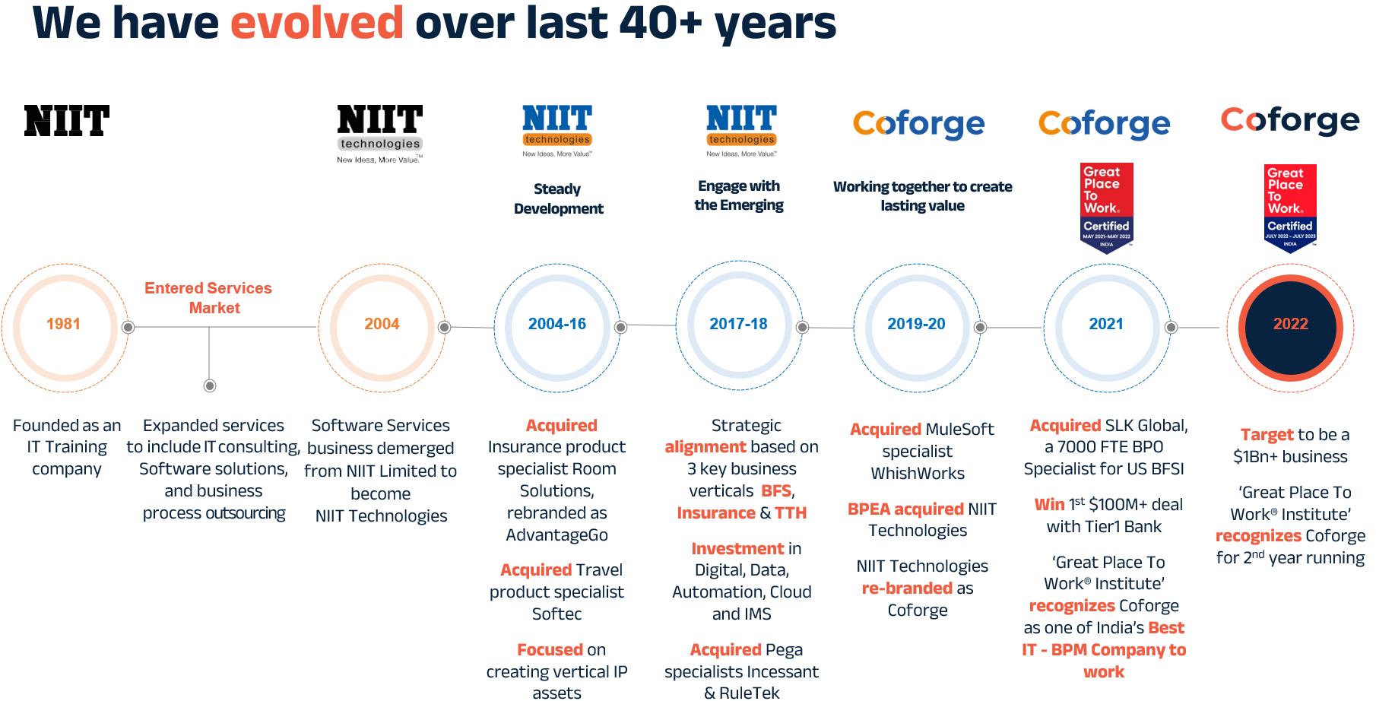
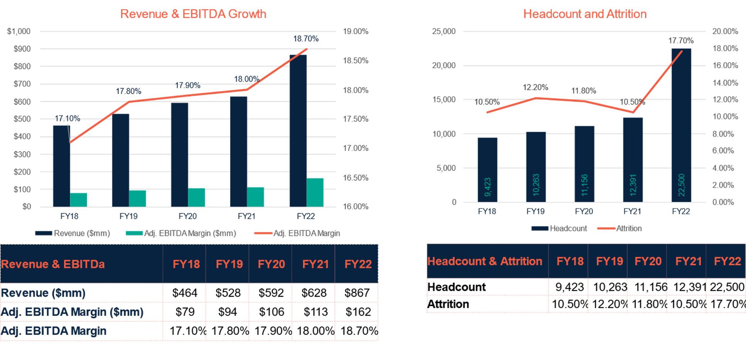
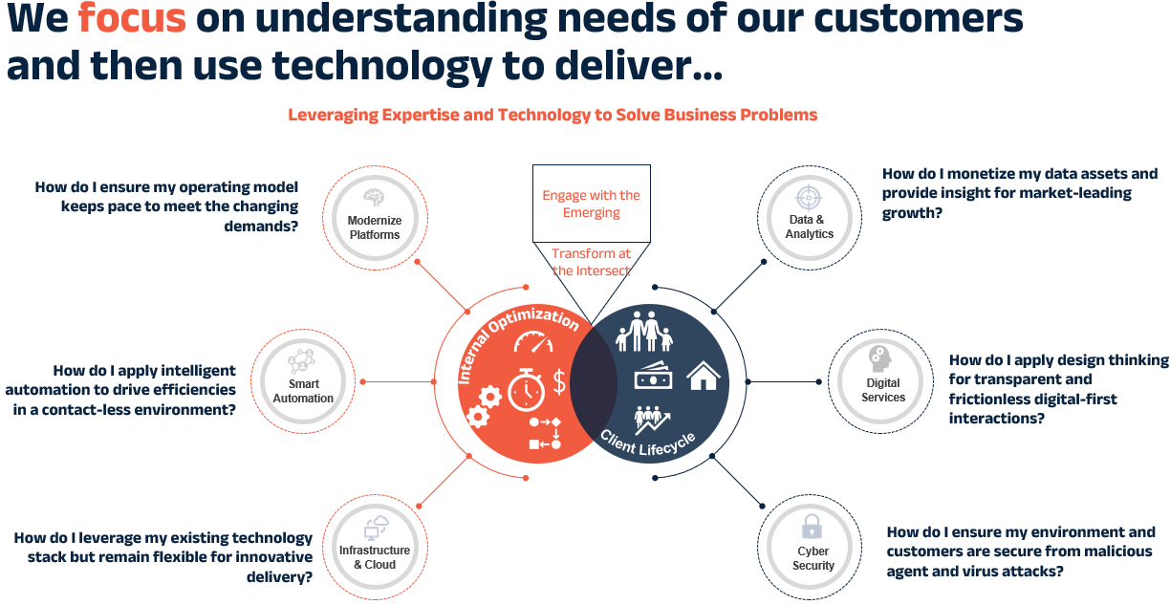
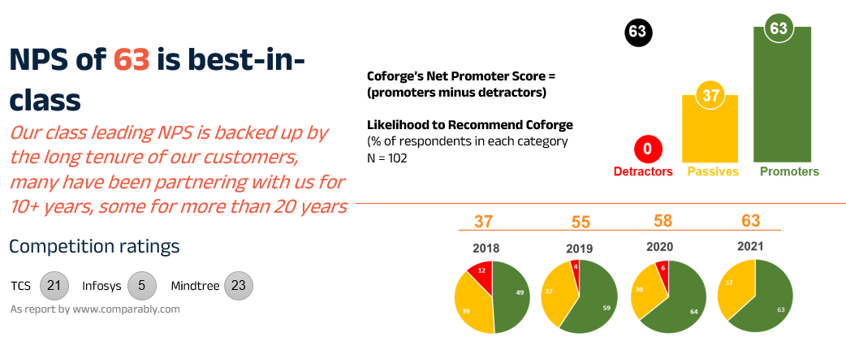
A 40+ year history with accelerated growth underpinned by delivery excellence, innovation & cost efficiency
Notes:
TCS – 21
Infosys – 5
Mindtree – 23

Slide 8
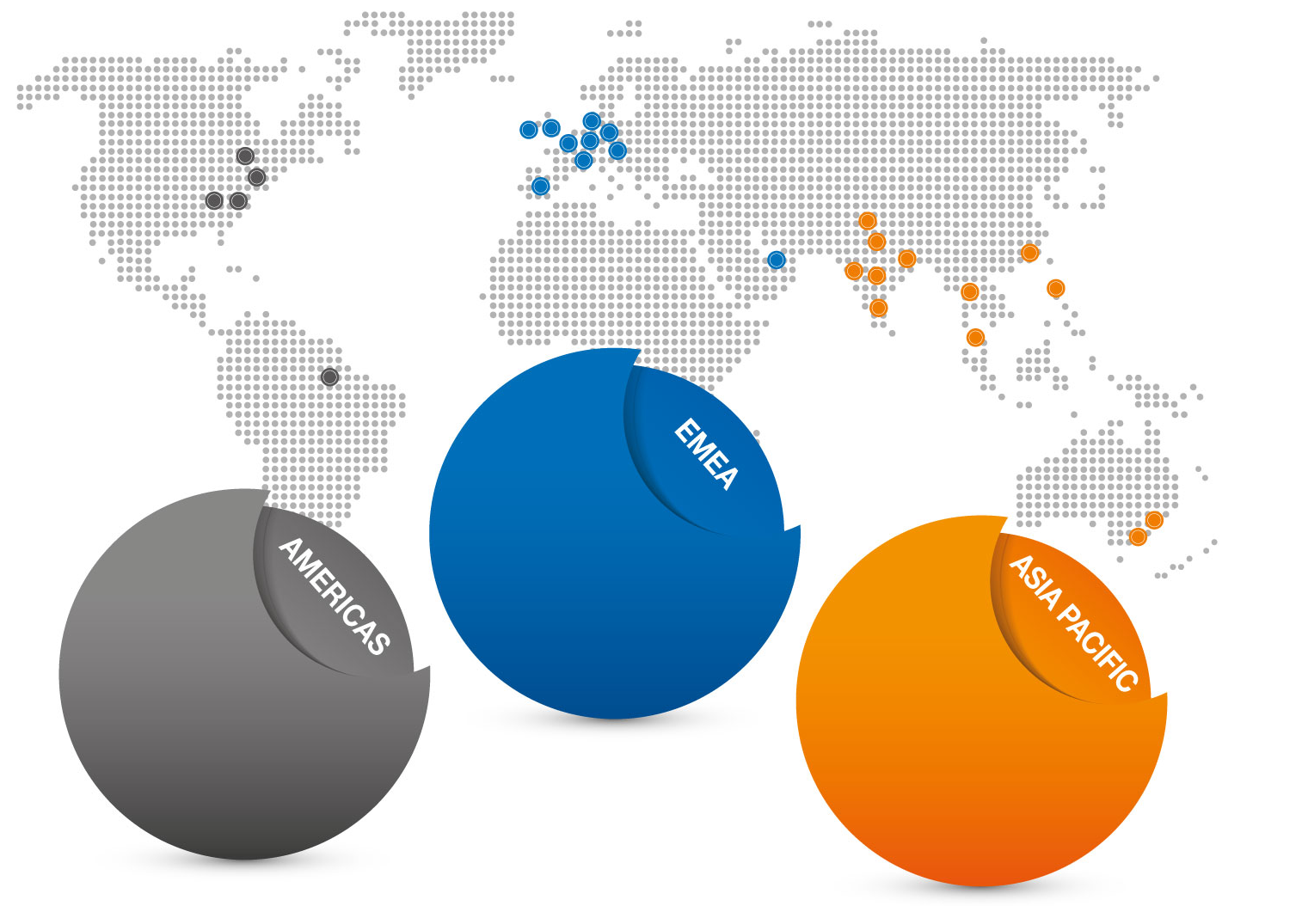
We have a global footprint that enables an efficient & flexible delivery…
North America Delivery Centre, Princeton
Proximity Delivery Centre, London
Nearshore Delivery Centre, Boise
Delivery Centre, Nuremburg, Germany
Proximity Delivery Centres, Atlanta, Chicago, Dallas & Las Vegas
Nearshore Delivery Centre, Madrid, Spain
Nearshore Delivery Centre, Augusta
Europe
Amsterdam
Diegem
Dublin
Frankfurt
London
Luzern
Madrid
Nürnberg
Zurich
Middle East
Dubai
USA
Princeton
Atlanta
Augusta
Boise
Dallas
Chicago
Las Vegas
India
Delhi/NCR
Bengaluru
Chennai
Hyderabad
Kolkata
Mumbai
Pune
Asia/ANZ
Bangkok
Hong Kong
Manila
Melbourne
Singapore
Sydney
Tokyo
Canada
Mississauga
Ability to deploy capabilities in the right place at the right time
25
Delivery Centers⁽¹⁾
15,000+
IT
FTE
6,950
BPO
FTE
46
Nationalities⁽¹⁾
21
Countries⁽¹⁾
Note: Based on IndAS financials converted to USD using average USD / INR exchange rate for respective periods.
(1) As of June 30, 2021; (2) As of FY21.

Slide 9
Service Capacity
Harish to review/ add pointers on AI & Metaverse
BUSINESS TRANSFORMATION
40+ success business transformation delivered across domains
250+ Lean Six Sigma certified Professionals
1600+ DPA & Low Code experts
350+ Appian certified professional
10+ Frameworks enabling transformation
100+ automation programs
PLATFORM MODERNIZATION
50+ Legacy Platform modernizations Program
40+ Cloud transformations
1200+ resources experienced in platform modernization
10+ Accelerators / tool vendors for mainframe modernizations
INFRASTRUCTURE & APPLICATION SUPPORT
12000+ Domain aligned Technology professionals
120+ Managed services engagements
60% team proficient in Digital & cloud
DATA
& ANALYTICS
2500+ Data Practitioners
45+ IP / Innovations
100+ Projects
75+ Active Customers
25+ Strategic Partnerships
PRODUCT ENGINEERING
100+ Product development engagements
5000+ resources in Agile based product development
50+ Design Think experts
400+ domain SMEs
QUALITY
ENGINEERING
95+ Customer Engagements
2300+ QE Professionals
1000+ Test Automation Staff
60+ Solutions/Accelerators
50+ AI, ML and RPA QE Use Cases
300+ Apps/Products Managed
IMPLEMENTATION SERVICES
2000+ certified platform consultants
SI for 200+ platforms
20000+ reusable test assets across domains
Frameworks for Managing Organization change
DIGITAL
CAPABILITIES & INNOVATION
350+ Projects
2000+ Digital certified consultants
28+ Technology Partnerships

Slide 10




Service Capacity
Harish to review/ add pointers on AI & Metaverse
No. of Resources
Capability areas
Web accessibility, Mobile first, Brand & SEO, Customer centric, HTML5, CSS3, LESS, SASS, Core JavaScript, React.js, Node.js, profiling/ performance tuning, ESI, Hybrid Mobile Apps, PWA, iOS (Swift) , Android (Kotlin), Content as a Service, Headless CMS, Tridion, Umbraco, CMS, A/B testing, web.
Digital
2000+ Digital certified consultants
3500+ employees, 1200+ resources experienced in platform modernization
Platform development
API Design, Java, Microservices, Spring Boot, Platform profiling/performance Tuning.
Databases
500+ consultants
NoSQL, RDBMS (Oracle, MS SQL, MySQL)
Container management
800+ Employees
Open Container Initiative (Docker, Cri-o, Containerd, rkt, Openshift, Kubernetes)
Site reliability engineering
250+ employees
DevOps, Operations at Scale, APM (AppDynamics), CDN (Akamai)
Cloud
2000+ employees, 80+ Clients
AWS, Azure, Google Cloud Platform, virtual networking, SDNs, OS (Linux)
Automation
1000+ employees
Selenium, Appium, TestObject, XUITest, Jest, Serenity, Non-functional testing
Security
500+ employees
Secure Coding, DevSecOps, SecOps

Slide 11
Key Services Provided
Harish to review/update
Coforge is a leading end-to-end IT solutions organization offering services in Application Development and Maintenance, Enterprise Solutions including Managed Services and Business Process Outsourcing to enterprises in the Travel & Transportation, Financial Services, Manufacturing /Distribution and Government sectors. ​
Business Process Operations
Application
Infrastructure
Digital
Products and IP
Modernisation
Portfolio Optimisation
Package implémentation
Next Generation Application Maintenance
Testing
Data Centre
DevOps
Autonomics
Cloud Integration
Tooling
IOM Services
Integration & BPM process orchestration
Mobility
Big data and analytics
Multi-channel commerce
Digital Architecture
Insurance
Travel
F&A
Platform-focused operations
Process automation
AdvantageSuite+
Monalisa
COSYS
Route Profit Analyser

Slide 12























Offerings
Product Engineering
Product Roadmap & Governance, Compliance
Product Support
Cloud Native
Cloud transformation
Cloud Native Dev
Microservices, API Ecosystem
Leg Modernization
Extend the Core
Integrate the Core
Modernize the Core
Office 365/Power Platform
Low Code Development
SharePoint, Workflows, Project Online, Intranet Unbundled, Agile Office
Agile Factory
Global Agile
SAFe, Spotify,
Scrum, Kanban
Automation
Process Mining,
RPA, IPA, Cognitive Automation
DevOps
Value Stream Mapping
DevOps Maturity
Lean Ops, NoOps
Site Reliability
Web3
Blockchain
Smart Contracts, NFT
Metaverse
RPA

Slide 13
Expertise at Client’s Place (Arshi/Ratan)

Slide 14
Staffing at Client’s Place (Arshi/Ratan)

Slide 15







Core Competencies
Digital Interactive
Digital Integration
Cloud Services
Application and Infrastructure
Digital Process
Data, Analytics & Cognitive
Quality Engineering
Experience
Agile connect
Convergence
Optimization
Automation
Intelligence
Techno Domain
CX/UX design
Digital Marketing
UI design and development, SPA, PWA
Mobile Applications
Omnichannel Exp
Experience Platforms (Sitecore/Adobe)
Service Enablement
API Lifecycle Management
Microservices
Product Engineering
Light weight Integration
Microservices
Cloud Transformation
Cloud Native Engineering
Cloud PaaS/Hybrid
Private Cloud
Manage & Govern
Application & Infra Support
Development
System Integration
Program Management & Governance
Cyber Security
Digital Process Automation
Low/No code (Pega/Appian/ Outsystems/O365)
Process Automation (RPA/iRPA)
Cognitive, AI, ML
Blockchain, Metaverse
Monetize for Insights
Data Governance
Data Engineering
Predictive Analytics
Product Quality and Risk Advisory Consulting
Automation Engineering
Product and Platform Validation & Verification
Cloud Migration & Cloud Testing
AGILE DEVELOPMENT | NEXTGEN APP MANAGED SERVICES | CONTINUOUS TESTING | DEVSECOPS
INNOVATION AS A SERVICE
Powered by DIGITAL ASSET STORE
Featured in HFS PoV – Change the Game with Verticalized AI
“Leader” in Nelson Hall NEAT Report for RPA & AI in Banking
ISG Briefing Notes Identified as being ahead of the Automation & Analytics Curve
“Leader” in Nelson Hall NEAT Report on Digital Experience Consulting

Slide 16
Best practices utilized when serving customers (Naina/Arshi/Ratan)

Slide 17
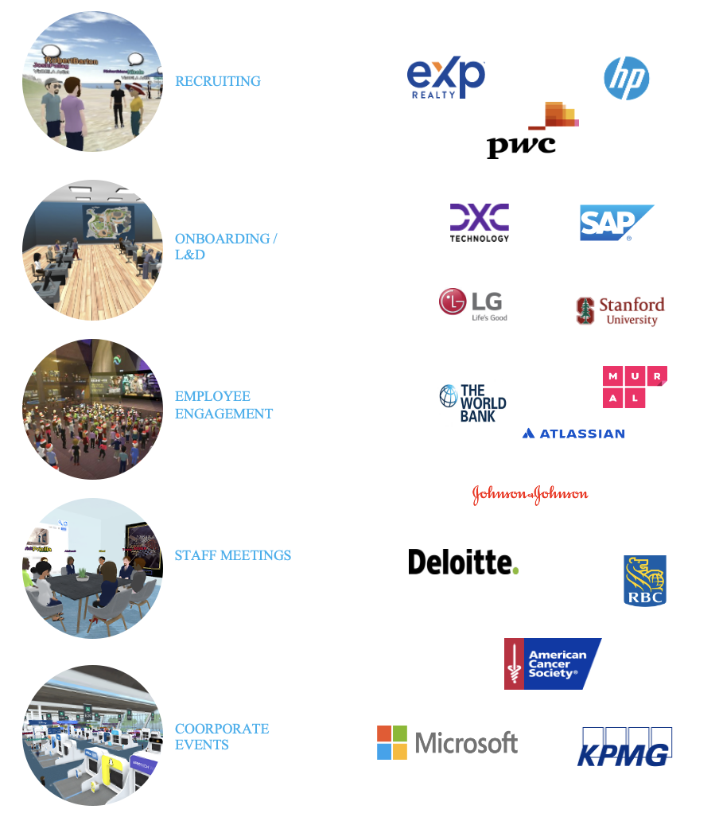
Customer Reference Sites (Virbela/Deepak/Harish)

Slide 18
Reference for AI, Metaverse & Azure

Slide 19
Client Reference (Virbela) (Pranjali to review)
Recent customer references from Virbela’s other products:
PwC - https://www.youtube.com/watch?v=uuoPrdJkN04
Deloitte - https://vimeo.com/469974208/5122e506b1
LG Electronics - http://cdnlms.lge.com/ext/002/B002/2021/08/31/a1d98810-6c29-4f57-bb59-8cf54544f074.mp4
DXC - https://www.weforum.org/agenda/2022/01/building-inclusive-metaverse-must-start-now/
Employee Engagement - World Bank Group, Deloitte, Gilead, Boston Scientific, J&J (World Bank Video - https://www.linkedin.com/posts/jvainstein_wordlbankvr-metaverse-ugcPost-6911699896446107649-ZzXI?utm_source=linkedin_share&utm_medium=ios_app)
L&D Training - Stanford GSB, MIT Sloan, LG, PwC, SAP, DXC, (LG Korea Video - http://cdnlms.lge.com/ext/002/B002/2021/08/31/a1d98810-6c29-4f57-bb59-8cf54544f074.mp4)
DXC created a Modern Workplace offering around Virbela to deliver differentiated workplace experiences to their customers in 70+ countries - https://dxc.com/us/en/insights/perspectives/paper/moving-into-the-metaverse
o Recent references made by FrameVR’s customers
Frame Enterprise Getting Started page (https://learn.framevr.io/resources) has great details on how organizations like PwC, Deloitte, Johnson & Johnson, SAP, and Stanford Graduate School of Business, MIT Sloas have deployed their Frame environments.
MSFT CTO Kevin Scott featured Frame at their annual developer conference last week - MS Build The Future of AI Development Tools (21min40sec)

Slide 20
Agenda
Executive Summary
Management Profile
Proposed Solution
Requirement Response
Project Management
Assumption & Dependencies
Training
Appendix B (Sub-Contractor Profile)
Appendix (About Coforge)
01.
02.
03.
04.
05.
06.
07.
08.
09.

Slide 21
Our Understanding of RFP Requirements
Deepak to review
Business Objective :
Build and implement a Metaverse platform for the Emirates Group which can deliver Immersive, collaborative, engaging experiences to all existing employees and future candidates and allow Emirates Group teams to operate, build and scale the Metaverse for future use cases.
Key Capabilities:
Provide reusable and interoperable digital assets
Be scalable with respect to content and audience to allow ability to deploy new experiences and scale for new departments easily.
Seamlessly integrate with enterprise applications within the Emirates Group technology ecosystem including the enterprise data lake platform
Meet the Emirates Group security standards and data privacy requirements.
Key Use Cases:
1. Overarching people experience
Attraction, Know us, collaboration and well being
Ability to connect, collaborate, interact and engage in real time
Ability to experience a Day in Life virtual office environment
2. Cabin crew service excellence
Inhabit and design a virtual classroom
Personalize the learning experience with context-based content
Dynamically change the content based on the interaction using AI
3. EK retail experience for staff (Group-level)
Personalize the retail shopping experience with 3D virtual stores, Emirates online store (3.0 roadmap)
Interactive e-commerce experience throughout the online purchase cycle

Slide 22
Scope: Key Functionalities
Deepak to review
The current scope includes the below use cases and functionalities on a high level. However, the platform would be scalable to develop and build additional use cases & future capabilities.
Human Resources & People Experience
Attraction
Info on EK, Brand Proposition (EBP), HR content
Content on Dubai, 'Emirates and Dubai Lifestyle' opportunities, Group brands, Careers
Crew & Retail Experience
Crew service
Crew learning
Virtual Aircraft cabin
Virtual classrooms
Know us
Insights into the 'real life and benefits’
Network, open forums, connections, influencers etc
Self Learning
Crew duty prep, rosters
AI coach
Uniform fitting & grooming
In Our World - Our Expectations
Expectations on role, timeliness, working hours, locations, teams, learning & development, AI coach
EK Retail
3D Virtual stores
Ecommerce shopping
Personalized shopping
In Our World – Day in life
Find out what your real day in a life experience can be with a virtual office environment
Payment modes
Emirates Online store (3.0 roadmap)
Loyalty – Earn, Redeem
In Our World – Collaboration
Communication and collaboration
Communities, People, Innovation, services etc
Rewards & Recognition
General
Health & well being
Existing well being tools & resources
Communities, support groups
Awareness programs and other information
Avatars
Emirates Virtual Assistant
Gamification

Slide 23





High Level Functional View
Deepak to review
Channels and Accessibility
Integration
I
NTEGRATION
LAYER
Web / Laptop/ Tablet
Crew Systems
Rostering (JCR)
Crew (Paradise)
Training (TMS)
Tablet
Mobile
Google glasses
VR Headset/wearables
HR
Crew service excellence
EK Retail
Admin
Getting to know us – EK HR content, Dubai content
Learning –
pre-onboarding
3D Virtual stores
Digital Asset Management
Learning & Trainings
LMS
SharePoint
How we work – Interactions, connections, forums
Virtual Aircraft Cabin/CSTs
Immersive & Personalized shopping exp
Content Management
EK Systems
Loyalty (CRIS)
Payroll
Talent Acquisition & onboarding
Enterprise Analytics
Corporate Payment Gateway
AD
Our expectations - HR policies, roles, A day in life – virtual office env
Virtual Classrooms, self learning
Ecommerce shopping
User access & profiles management
Collaboration – sharing, engaging, communicating
Crew Duty Prep, AI coach
Payment methods
(credit card, skymiles, salary)
Hub & spokes – content personalization
ERP
HCM
Product Inventory
Health & well being – health and wellbeing tools & options
Uniform fitting & grooming
Reports
Earn/Redeem – Skymiles
Other third party
Destination content
Dubai Tourism
Digital Identities
Experience
Build your Avatars
Virtual Assistant
Personalization
Content Gamification
AI Bots

Slide 24
Key Components
Deepak to review
Given below are the Component “layers” that constitute the physical and operational structure on which the metaverse experiences are based
1. Apps, Content & Experiences
Apps: Collaboration, Learning, Retail as per the defined use cases
Virtual worlds: Virtual training rooms, office environment, virtual store & environments where users can gather, interact, create various experiences
Content: Content creation, videos, dynamic content
2. Core Platform: Core set of tools and platforms for building 3-D experiences—including core platform, AI services, other tools?
3. Infra and Hardware: Device hardware, components, accessories/peripherals, Infra across cloud, networks
4. Enablers:
Security, privacy, and governance
Identity – Digital Avatars
Payment and other tools
Apps, content & Experiences
1
Core Platform
2
Infra and Hardware
3
Enablers
4

Slide 25
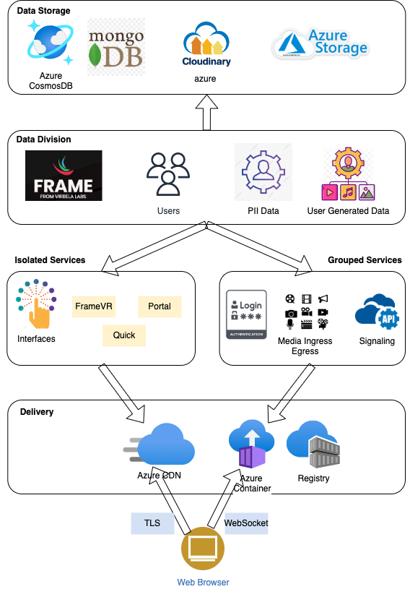
Architecture Overview (Amit)
Explain the Archirecture in bullet points

Slide 26
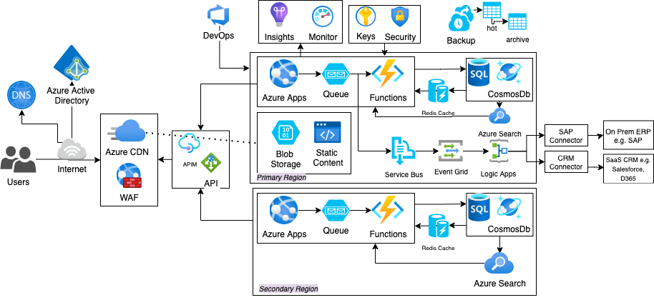
Application Architecture (Amit)

Slide 27
Response to product Technical Questionnaire Amit, Deepak) – File DDC7FF23

Slide 28
Agenda
Executive Summary
Management Profile
Proposed Solution
Requirement Response
Project Management
Assumption & Dependencies
Training
Appendix B (Sub-Contractor Profile)
Appendix (About Coforge)
01.
02.
03.
04.
05.
06.
07.
08.
09.

Slide 29
Functional Requirement (Deepak)
File Name: Worksheet in section 3.1 (HR experiences and Ops functional Requirement)

Slide 30
Non-Functional Requirement (Amit, Om, Rachna)
File: NFR for RFT Metaverse

Slide 31
Security Questionnaire
Attach Excel sheet(PCI-DSS, Data Security etc)

Slide 32
Security Document IS2C2 (application Security)

Slide 33
Deployment Architecture (Amit)

Slide 34
Testing Requirements (Karthik refer section 1.2.2 for more details)
Test Management | Slide#
Can you provide an experienced single point of contact for the Test Management and coordination required during Test Planning, Design and Execution?
Can you describe the types of test reporting which you provide during the course of the project for all project stakeholders?
Can you provide generic Business Process scenarios for Test execution
What is your approach towards Defect resolution plan and Triages?
Describe what Test tooling you have available for you?
Test Coverage
Describe System Testing of the base product release and any customizations added or configured for all functional and non-functional requirements listed the RFT
Explain your approach of End-to-End Business Process Testing?
What is your approach to Interface Testing including 3rd party applications
What can you provide in terms of an approach and plan for automated Regression of product releases to determine/validate the impact on any working features.
What practices do you have in place for Vulnerability Assessment and Penetration Testing (VAPT) and Security compliance checks like Data Privacy, PCI DSS and GDPR?
Describe the approach you take non-functional requirements like Performance Tests, Availability, Reliability, Compatibility, etc,
What coverage do you provide for Network emulation tests covering all real-world network conditions, including but not limited to, bandwidth, latency, packet loss and jitters
Describe your approach to Resiliency and Reliability tests and conformance to the SLAs and NFRS w.r.t to availability and reliability? (including disaster recover tests/plans)
Explain your approach for the testing of any Data Migration requirements

Slide 35



Scope of Testing
Testing Types
What to Test
End User Experience
Learning & Gamification
Personalization
Application behaviour in different network conditions
Immersive experience
Content and personal data security
Reliability and resiliency to have seamless experience
Functional Testing
Interface Testing
System Testing
System Integration Testing
End-to-End Business Process Testing
Regression Testing
Test Automation
Non-Functional Testing
User Interface Testing
Compatibility Testing
Performance Testing
Security Testing
Network Simulation Testing
Resilience and Reliability Testing
Persistence – Content and all personalization done are available as it is, when user visits again
Static Content
User interface
Avatars
Virtual spaces
Office environment
Virtual store
Environments
Dynamic Content
Documents
Audio
Video
Experience
Shared experience – Users can interact, communicate and collaborate across metaverse
Content
Compatibility – The content and functionality are accessible across devices
Functionality
HR module
Crew service module
EK retail module
Admin module
Virtual assistant
AI bots
Software

Slide 36
Testing Strategy
We will implement our proven Agile testing model for assuring the base product release and customizations or configuration for all functional and non-functional requirements. The below model depicts the phases of testing,
Project Phases
Testing for Code Drops/Agile Sprints 1…n
(Parallel Sprint Teams)
Hardening Sprint
UAT / Go-Live
Test Phases
In Sprint Testing – Parallel Streams
Hardening Sprint Testing
Acceptance Testing
Test
Initiation
Test Preparation
Test Execution
End to End (E2E) Testing
Acceptance Testing
Requirement Analysis
Test Design
Interface Testing
System Integration Testing
E2E Business Process Testing
User Acceptance Testing
Testing Services
Test Planning
Test Data Setup
System Testing
Alpha Testing
Regression Testing
Performance Testing
Static Testing
Test Environment Readiness
User Interface Testing
Beta Testing
Compatibility Testing
Security Testing
Network Simulation Testing
Test Automation
Manual/Automated Regression Testing
Resilience and Reliability Testing
Go-live Acceptance Testing
Test Automation
Test Deliverables
Test Strategy/Plan
Test Scope
Test Schedule
Test Scenario/Cases
Test RTM
Automated Test Pack
Test Execution Results
Test Reports (Daily/Completion)
SIT Results
Performance Report
Security Test Report
Acceptance Test Execution Reports
Acceptance Test Support
Acceptance Test Defect-fix Retest
Coforge Value Proposition
Shift-Left of Testing using Dev-Test Sessions
Faster Testing using Test Automation
Higher Quality using Model Based Testing
Optimized Compatibility Testing using Device Testing Matrix

Slide 37

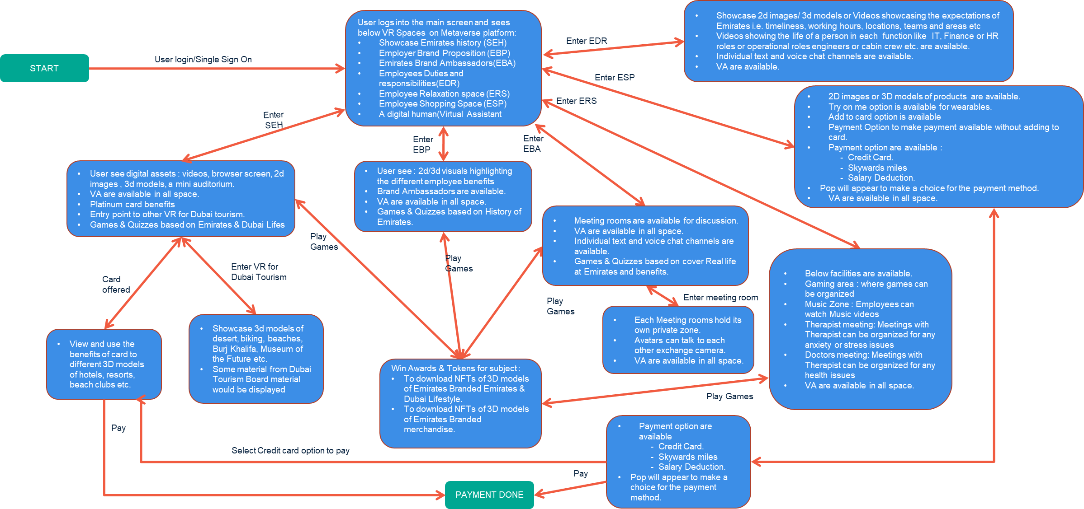





End-to-end business process testing approach
End-to-end business process testing
involves testing of the complete metaverse modules integrated with EK applications to assure that the metaverse ecosystem performs as intended and provides immersive user experience across its components and functionalities
Indicative Model for Key EK HR Use Cases
Model based testing approach to better understanding of the multitude of possibilities in the metaverse application.
The different states form the vertices and actions the edges.
Single and multi-user manual testing to assure better collaboration and interactivity between users.
One-to-one, one-to-many and many to many interactions across modules and devices
Device compatibility testing to ensure that content and application functionalities enable end-to-end business processes across different mobile devices, wearables and browsers
Coforge Methodology

Slide 38
Indicative model for key EK HR use cases
The model created for each module will be leveraged for creating the test scenarios, which will be further elaborated into test cases.
Sample Test Scenarios for HR Use Case
Validate that user is able to login to the EK metaverse and visit the galleries and retail space as per his role
Assure that a digital human/ virtual assistant is always available and accessible from anywhere in the metaverse
Validate the required contents for each space like 3D objects, 2D images, auditorium, screens etc.
Validate gamification of the content like quizzes
Validate users are able to pay using credit card, Skywards miles or avail deduction from salary

Slide 39
User logs into the main screen and sees below VR Spaces on Metaverse platform:
Showcase Emirates history (SEH)
Employer Brand Proposition (EBP)
Emirates Brand Ambassadors(EBA)
Employees Duties and responsibilities(EDR)
Employee Relaxation space (ERS)
Employee Shopping Space (ESP)
A digital human(Virtual Assistant
Showcase 2d images/ 3d models or Videos showcasing the expectations of Emirates i.e. timeliness, working hours, locations, teams and areas etc
Videos showing the life of a person in each function like IT, Finance or HR roles or operational roles engineers or cabin crew etc. are available.
Individual text and voice chat channels are available.
VA are available.
Enter EDR
START
User login/Single Sign On
Enter ESP
Enter ERS
2D images or 3D models of products are available.
Try on me option is available for wearables.
Add to card option is available
Payment Option to make payment available without adding to card.
Payment option are available :
- Credit Card.
- Skywards miles
- Salary Deduction.
Pop will appear to make a choice for the payment method.
VA are available in all space.
Enter SEH
Enter EBP
Enter EBA
User see digital assets : videos, browser screen, 2d images , 3d models, a mini auditorium.
VA are available in all space.
Platinum card benefits
Entry point to other VR for Dubai tourism.
Games & Quizzes based on Emirates & Dubai Lifes
User see : 2d/3d visuals highlighting the different employee benefits
Brand Ambassadors are available.
VA are available in all space.
Games & Quizzes based on History of Emirates.
Meeting rooms are available for discussion.
VA are available in all space.
Individual text and voice chat channels are available.
Games & Quizzes based on cover Real life at Emirates and benefits.
Play Games
Enter VR for Dubai Tourism
Play Games
Below facilities are available.
Gaming area : where games can be organized
Music Zone : Employees can watch Music videos
Therapist meeting: Meetings with Therapist can be organized for any anxiety or stress issues
Doctors meeting: Meetings with Therapist can be organized for any health issues
VA are available in all space.
Card offered
Play Games
Enter meeting room
Showcase 3d models of desert, biking, beaches, Burj Khalifa, Museum of the Future etc.
Some material from Dubai Tourism Board material would be displayed
Each Meeting rooms hold its own private zone.
Avatars can talk to each other exchange camera.
VA are available in all space.
View and use the benefits of card to different 3D models of hotels, resorts, beach clubs etc.
Win Awards & Tokens for subject :
To download NFTs of 3D models of Emirates Branded Emirates & Dubai Lifestyle.
To download NFTs of 3D models of Emirates Branded merchandise.
Play Games
Pay
Payment option are available
- Credit Card.
- Skywards miles
- Salary Deduction.
Pop will appear to make a choice for the payment method.
Select Credit card option to pay
Pay
PAYMENT DONE

Slide 40
Device compatibility testing approach
The Device Compatibility Testing matrix is a tool to optimize compatibility testing using a risk-based approach
Device compatibility testing ensures that the content and application functionalities are the same across different mobile devices and browsers
Test Planning
Prioritize test scenarios
Develop compatibility matrix
Analyze automation feasibility
Develop Scripts
Test Execution
Execute compatibility test cases as per the compatibility matrix
Report issues
Analyze OS/Device trends
What to test across devices and browsers:
The objects in the virtual space and the personalization are available and appear the same
The application functionalities perform as expected
Users joining from different devices have the same shared experience
Device Compatibility Matrix
Test cases are prioritized based on the criticality of business process from P1 – P4
Automated visual testing scripts will be executed across all devices
The given device compatibility matrix will be finalized with EK before execution
Device /Browsers (EK requirements) | Test Execution |  | Deevices
 | P1 | P2 | P3 | P4
Windows 10 PC with Chrome | ✓ | ✓ | ✓ | ✓
iPhone with iOS v16 (Chrome) | ✓ | ✓
iPhone with iOS v15 (Chrome) | ✓ | ✓ | ✓ | ✓
iPadOS 15 (Chrome) | ✓
Samsung Galaxy with android 12 (Chrome) | ✓ | ✓ | ✓ | ✓
Samsung Galaxy with android 11 (Chrome) | ✓ | ✓
ILLUSTRATIVE

Slide 41
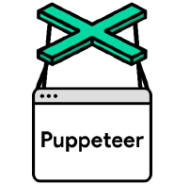



Progressive interface testing approach
Our progressive interface testing approach ensures that all contracts/services, integrating with EK internal/3rd party systems are performing individually and enable execution of end-to-end business processes.
Testing from the UI to ensure that application confirms to the business process workflow and functional requirements
Non-functional testing to validate application conformance to non-functional requirements and SLAs
E2E
Testing
5
Test/Pre-prod Environment
Integration
Testing
Validates pairs/ clusters/ orchestration of services to cover every potential point of failure
Validates business workflow/ processes scenarios enabled by services
4
Test Environment
Tests each service on a stand-alone basis through request response validations
Leverages service virtualization if needed
Basic performance testing of each service
Service Testing
3
Automated contract testing of the APIs to ensure communication between APIs/microservices
The tests are based on consumer and provider contracts
Contract Testing
2
Dev Environment
1
Automated testing of each module/function of code written
It is performed by developers
Unit testing code coverage will be > 80%
Unit Testing

Slide 42



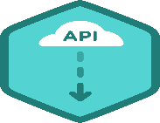
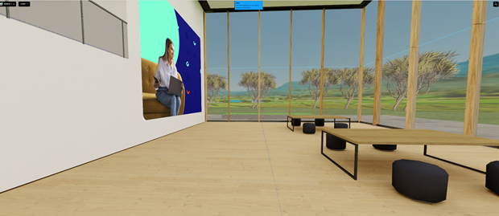
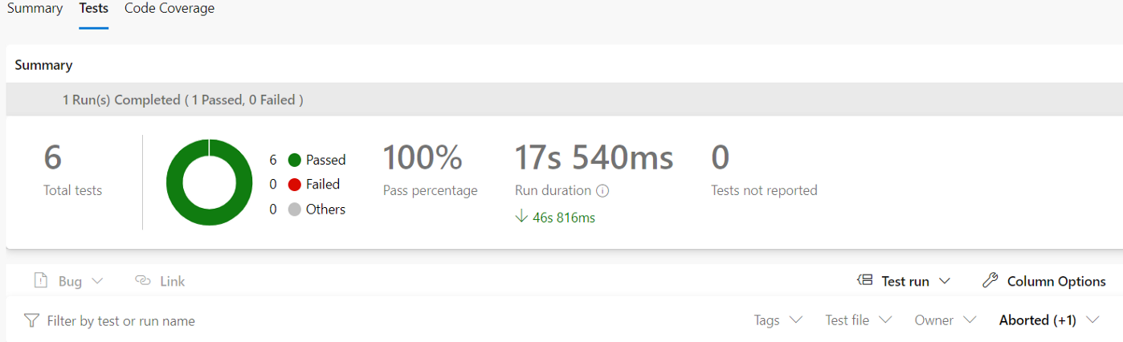

Test automation methodology
Coforge will implement MetaQX our in-house low code / no-code metaverse visual test automation framework, to automate testing during sprints.
Test Automation Approach
Automation Analysis to Identify Test Cases for Automation
Automate Functional Test Cases during Sprint Testing
Execute Automated Regression & Functional Test Cases
Maintain Automation Scripts for Changes in Application
Enablement Features
Test Automation Framework
Puppeteer integrate with jest to handle visual regression testing.
Expected Screenshots
BDD Based Test Case
Common Libraries
Azure DevOps
Given avatar is on auditorium page
When avatar takes screenshot
Then avatar assert Image1.png
Step definition
Environments
Dev
Automate test data management in the form of screenshots which makes better test coverage
Business Logic
Test
Pre-Prod
Prod
BDD based test case written in simple plain English.
Metaverse Application
Final Report
Automation Engine
Parallel headless test execution & Customized Error handling
Continuous testing by integrating with the CI/CD pipeline in Azure
Solution Considerations
High customer experience
Faster test automation creation
Open source solution

Slide 43
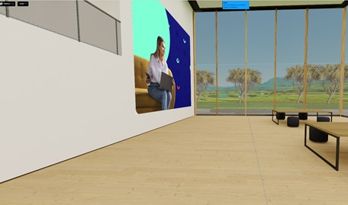
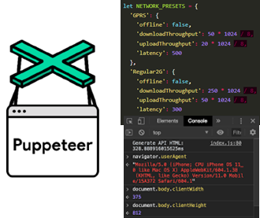
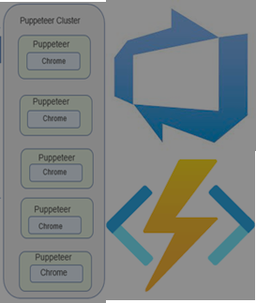
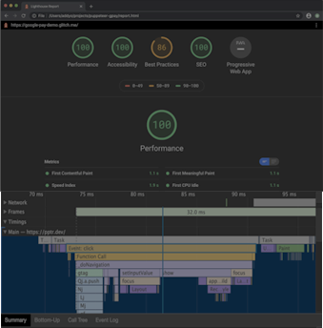

Performance testing approach
Our 5-step performance testing approach
Requirement
Analysis
Test
Design
Performance
Test Execution
Result
Analysis
Performance
Optimization
Understand modules and workflows
Classify performance testing areas (virtual spaces, sessions etc.)
Identify load parameters
Select network emulation scenarios
Create test automation script for each identified performance scenario
Prepare required network configuration
Workload modelling for load, concurrency and duration
Create test data
Create scripts for collating performance data
Execute one user test for creating baseline report
Execute automation script in clusters as per the concurrency and network emulation
Ramp-up and down the load as per workload
Execute script for result collation
Collate performance results for
Normal & peak load
Stress & scalability
Availability & endurance
Performance analysis with baseline report
Data reconciliation against baseline
Performance tuning
3D model sizes
No. of models in a frame
Frames per second
SQL optimization
Performance Testing Requirement Analysis
Test Scripts, Test Plan and Workload Model
Test Execution Report, Failure Logs
Results Analysis Report
Optimization Recommendations
Performance Testing Activities
Deliverables

Slide 44
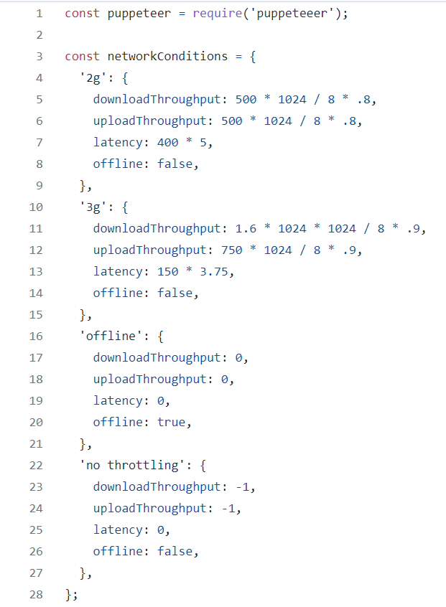

Network emulation testing methodology
Network emulation
To validate performance of the metaverse application against realistic network conditions, it is necessary to simulate and performance test against various network conditions.
Network Emulation creates different networking conditions. It allows creating situations with data loss, errors, jitter, high latency, and low bandwidth.
We will utilize the ability of puppeteer to emulate network conditions using Network.emulateNetworkConditions property of the Chrome DevTools, for performing network emulation testing.
We will execute test automation scripts with different network conditions during performance testing. We will do performance validation for a particular network condition (2G, 3G etc.) and a combination to get a real-world testing scenario.
The figure depicts the different network configurations, which will be finalized in consultation with EK, before execution.

Slide 45
Security testing approach (confirm with Arshi)
What practices do you have in place for Vulnerability Assessment and Penetration Testing (VAPT) and Security compliance checks like Data Privacy, PCI DSS and GDPR?

Slide 46
Resiliency and reliability testing approach
Resiliency testing will be performed with each major release to enable improvement of quality of website and enhance customer experience. It will be executed in pre-prod environment which is close to production environment
Approach
Key Components
Identification
Plan
Execute
Monitor & Analyze
Cloud and Infrastructure Resilience
Azure
Network
Application Resilience
Error Logs
API/Integrations
Database
Heavy and large images
Device Resilience
Device Fault
Business: Data Resilience
Data Corruption and Recovery
RTO and RPO
Identify mission critical services, Risk of service failure; solution to mitigate identified Risk, adverse events & conditions, test scenarios
Team, Test Environment, tools, etc.
Simulate test scenarios
Capture matrices, observations, analyse and recommend
Key Test Scenarios
Adversity which can disrupt – No or Low Network bandwidth, Application components or part being unresponsive (E.g. Integration failure, service failure, hardware failure, slow database connection etc.)
System to be tested for detection of fail event, respond appropriately and recovery from the situation/fail state.
identifying deficiencies in the applications hosted on Azure to be able to scale out, ensure performance criteria are met and resources are utilized optimally. .

Slide 47

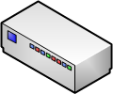
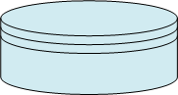
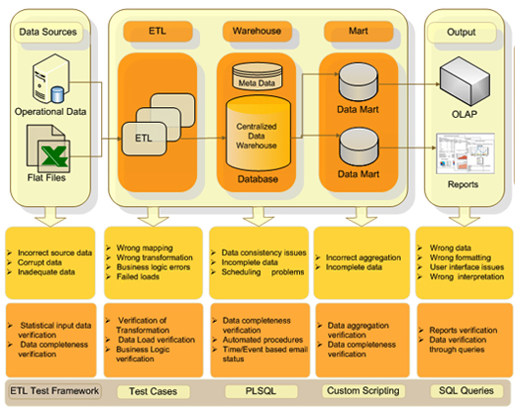
ETL and data migration testing approach
Validations performed during data migration.
Data Sources
Landing Layer
Staging Layer
Curated Layer
Dissemination
Batch
Database
Data Warehouse
(DWH)
Integration
Data from various sources
Streaming
Data Ingestion
ETL
ETL
Historical data
EI Layer
Visualization
Source validation
Count Validation
Data Check
Data consistency check
Data completeness check
Data value check
Compare data between landing & staging layers
Duplicate data check
Data Integrity check
Structured data check
Data Transformation
Use data profile and data rules components to identify data quality issues
Compare data between staging & curated layers
Data classification check
Referential integrity validation
Data quality or missing data check
Aggregations
Error logging / Exception handling / Recoverability
Data schema validation as per Varicent requirements
Data quality or missing data check
Data classification validation
Business data validation
Error logging / Exception handling / Recoverability
Reconciliations & Validations

Slide 48
Testing toolset
We will utilize the testing toolset available at Emirates for performing the testing services and implement new tools as required.
Testing Type / Area | Tools and Technology
Test Management | Test Rail
Defect Management | JIRA
Interface Testing | Postman (Open-source tool)
Test Automation | PACT (Open-source tool) Cucumber (Open-source tool) Puppeteer (Open-source tool)) Jest (Open-source tool)
Performance Testing & Network Emulation | Chrome Developer Tools (Open-source tool)
Service Virtualization | Hoverfly
Security Testing

Slide 49
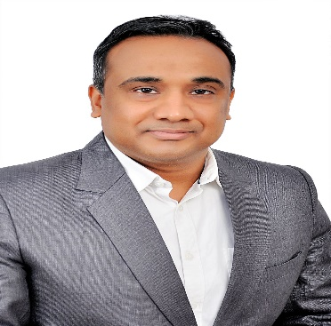
Testing governance
Merged with overall Governance
Sr. Test Architect
18+ years experience in multiple domains like
Telecom, Travel, Healthcare and Insurance
PMP, Safe and DevOps certified Delivery Leader with extensive experience in Test Management and Consulting
Extensive Test Management, Automation and Non-functional testing experience
Experienced in designing strategic Testing transformation plans and implementing target-operating model across mid to large sized teams
Experienced in leading multiple Testing programs, covering Functional, Automation and Non-functional testing
Leveraged skills in establishing and growing Global Delivery teams, and alleviating the deliveries by implementation of ‘right fit’ processes, through aggressive project and test governance processes
Managed the projects by following Agile-Scrum and Kanban methodology as well as Waterfall models
experienced single point of contact for the Test Management and coordination required during Test Planning, Design and Execution
Vishesh Kumar Gupta

Slide 50
Communication and reporting
Merged with overall Governance
# | Communication | Purpose | Timing / Frequency | Attendees / Recipients
1. | Daily Stand-Up | Status updates of progress, impediments and ongoing planning. | 30 Minutes at start of the day | Coforge Testing Team
2. | Daily Test Status Report | Testing progress update to all project stakeholders | Daily end of the day | Coforge Test Lead
3. | Weekly Status Review meeting with Business and Release Manager | To discuss testing progress,, defects and impediments | Weekly for 30/60 mins | Coforge Test Lead, Release Manager, EK Business and other release stakeholders
4. | Operational status review meeting : To review Service performance | To review progress status | Monthly for 1 Hour | EK Business Heads and Project Manager Coforge Client Partner, Delivery manager and Test manager
5. | Quarterly business review | To review service status | Quarterly for 1 hour | EK Project Sponsor, Business Heads, Portfolio Manager, Project Manager Coforge Client Partner, Coforge Delivery Head, Test manager

Slide 51

Indicative Testing SLAs and KPIs
Metrics | Target | Frequency
Defect Slippage to UAT | 3% – 5% | Release
Defect Slippage to Production | 2% - 3% | Release
Value Adds Delivered NIMV | 2 - 3 | Yearly
Customer Satisfaction (NPS) | 9 – 10 | Yearly
Resource Onboarding Onsite/Offshore | 4-8 / 2-4 weeks | Quarterly
Strategic Metrics
Cost
Quality
Cycle time
Enterprise
Metrics | Target | Frequency
Schedule Variation | <5% | Release
Idea implemented per IT Area | 1 - 3 | Quarterly
% of Automation Achieved | As per the plan | As per the plan
Cost of Quality | 5% to 10% reduction | Yearly
Test Environment Downtime | <2% | Release
Tactical Metrics
Schedule
Effort
Automation
Program
Metrics | Target | Frequency
Testing Productivity | To be baselined | Monthly
Testing Efficiency | To be baselined | Monthly
Defect Density | >10% | Monthly
Defects Aging | <10 days | Monthly
Defect Retest Rate | <10% | Monthly
Operational Metrics
Productivity
Test case
Defects
Project
Note: Above are typical metrics and targets, final targets will be discussed and finalized in collaboration with EK

Slide 52

Defect management model
The below mentioned model is based on our experience of working in various similar projects. Coforge will update the process to align with the defect classification and management process followed at EK.
Defect Management Process
Defect Triage Meetings
Process Starts
Weekly Defect Triage Meetings
Defect Dashboard
Defect Review
Defect Assessment
Defect Assignment
Create a defect in defect management tool
Validate the fix
Valid Bug?
Yes
No
Platform Bug?
Assign it to Developer
Key activities in Triage Meetings
Defect dashboard consists of defect counts per status, details of open defects and defect ageing.
Review open defects for severity and prioritize for resolution.
For defects assigned to platform vendor, ensure that defects is raised in the vendor defect management tool.
Review rejected defects to validate the reason for rejection.
Discuss status of ageing defects and clarify issues related to defect.
Review fixed defects and clarify issues related to closing the defect.
Defects could be deferred to a future release or even closed, if the team agrees, after required investigation.
Fixed?
No
Yes
Bug Fixed
No
New Build deployed
Yes
Update Defect in Vendor defect mgmt. tool and link defect with external defect ID
Close Bug in Defect Mgmt. tool
End
QA Team
Development team

Slide 53




Coforge value proposition
Shift-Left
Testing
Faster
Testing
Higher
Quality
Optimized
Testing
Dev-Test Sessions.
Test Automation.
Model Based Testing.
Device Testing Matrix.
Coforge will implement Dev-Test sessions, in the development environment
The tester will have exploratory testing sessions in the dev environment, before moving the build to QA
The build is deployed to QA only when no defects are found in the dev-test session
This will enable early defect detection
Automation scrips will be developed for content and API testing
Test scripts leverage for automated build verification and regression testing
Basic performance testing using test automation for early identification of performance issues
Reduced test cycle time and effort
Coforge will implement model-based testing methodology for better understanding of the multitude of possibilities in the metaverse application
Models will be created by tester and reviewed by EK team
Test cases would be generated from the model
This ensures higher test coverage of the metaverse application
Coforge will build a device testing matrix for compatibility testing
The matrix will specify the amount and level of testing to be done for each device/browser
The matrix is derived on the principles of risk-based testing technique
This will help optimize testing across devices/browsers for compatibility

Slide 54
Testing Approach & Strategy (Karthik)
Project Test Strategy review and signoff.
Different types and cycles of testing that IT and Business will perform on the product, based on the Test Strategy finalised.
Provide us frequent drops/builds to enable an Agile approach towards testing, with sufficient regression test runs to ensure integrity of build
Provide us release notes with every release/drop detailing the changes/fixes delivered, open defects, release version number etc.
End-end Defect Management using Emirates Group’s Defect Management Solution - JIRA (access will be provided to Supplier); or through Supplier’s defect management tool.
Participate in Regular defect triage calls and assign required resources for Test coordination throughout the duration of the project.
Fast track defect resolution and control the quality of product releases made to Emirates Group, in accordance with the Testing SLAs agreed in the Test Schedule.
The Emirates IT team will establish a Test Schedule (as part of MSA) along with high level Test Strategy, Testing SLAs with the selected Supplier. Some of the key Testing SLAs include - control of Defect density rate, Ageing of Defects (Defect Resolution Time) and Defect Retest Failure rate, Downtime on Test environments due to failing Supplier patches or releases etc. Deliverable expected from the Supplier will also be agreed during Test Schedule finalisation

Slide 55
Infrastructure (Amit & input from Virbela)

Slide 56
Operations Service (Amit)
(Section : 3.3.1, File : Questionnaire for Data Center Standards)

Slide 57
IT Services and Business Continuity (Amit)
Section 3.4, File names: Business Continuity Requirement xl & Business continuity plan

Slide 58
Performance Standards (Ratan/Arshi)
Service Levels
The Supplier shall provide the maintenance and support services in accordance with the Service levels applicable for the tier level set out below (as further detailed in Appendix A). Supplier shall be responsible for any service credits associated with its failure to meet such service levels
Tier 0
Tier 1
Tier 2
Tier 3
Refer file SLA and Service Credit compliance file in Appendix A

Slide 59
IT Security Requirements (Section 3.6 Security Documents) (Rajiv)

Slide 60
Agenda
01.
02.
03.
04.
05.
06.
07.
08.
09.
Executive Summary
Management Profile
Proposed Solution
Requirement Response
Project Management
Assumption & Dependencies
Training
Appendix B (Sub-Contractor Profile)
Appendix (About Coforge)

Slide 61

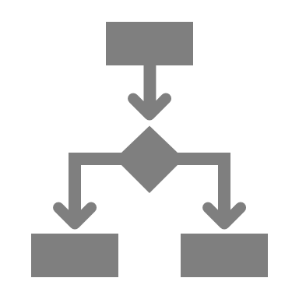



Implementation – Key Aspects
Operating Model
Risk Management
A “One-team” model
Clear alignment to the objectives of the transformation.
Simple reporting structure with clear accountability
Clearly defined roles & responsibilities
Clearly defined interactions with Client
Every change comes with inherent risks.
Identify, track & mitigate all risks before they become issues.
Assess criticality based on probability & impact
Risk mitigation & remediation
Regular review of risks & associated issues.
Governance
Change Management
Clearly defined plans & status reports to give visibility on progress.
3-tier model deployed re: daily stand-ups, weekly review & monthly steering.
Clearly defined escalation matrix
Communication of objectives is clearly understood
All parties are engaged & supportive.
Handle concerns
Manage introduction of new working practices & processes
Oversee all training.

Slide 62








Our Project Management Framework
Coforge follows a comprehensive project management methodology compliance with its Quality Management System (QMS). This QMS is fully compliant to ISO 9001:2008 and SEI CMMi Level-5 guidelines.
Key Principles
Creation of a Shared Vision and alignment of the project plans with the strategic business drivers of the customer and all relevant stakeholders
Clearly defined project deliverables, relevant stake holder’s dependency, milestones, expectations and objectives
Direct ownership of project elements and deliverables as per the defined templates
Continuous, direct communication and participation of all relevant stakeholder
Minimize project risks by up-front planning and analysis, and contingency planning along with relevant stake holders
Focus on effective change control and Knowledge Management
Project communication strategy which will facilitate successful co-ordination and collaboration among the different stakeholders
Facilitate the implementation of the project or solution smoothly without interruption to the customer’s normal business
Initiation
Post
Implementation
Review
Project
Definition
Implementation
& Closure
Project Management Framework
Planning
Monitoring
and Control
Detailed
Planning
Execution
62
© 2022 Coforge I Strictly Confidential | EK Group

Slide 63






Project Management – Key Activities & Deliverables
Deepak to vet
Coforge’s project management framework provides the guidelines for activities and deliverables at different stages. We will align our approach as per the DA standards and guidelines given in the RFP document. We will use JIRA as project management tool.
Initiation
Planning
Execution
Monitoring & Control
Implementation
& Closure
Define common vision
Define project objectives
Establish key stakeholders
Define Roles & Responsibilities
Risks Register
Re-Estimate project scope
Define critical success factors
Scope of statement
Risk management plan
Process management plan
Quality Assurance plan
Gap Assessment
Config management plan
Change control protocol
Resource management
Execution as per agile methodology
Sprint planning
Design
Build
Testing
Sprint Demos / retro sessions
UAT
Training
Quality Assurance
Project audits
Final Inspections
Independent testing unit
Peer reviews
Identify lesson learnt
Customer satisfaction survey
Knowledge transfer to customer
Product implementation
Activities
Tracking
Defect tracking
Metrics tracking
Project reviews
Phase end reviews
Detailed project plan in MPP
Project Schedule
System Requirement Specification
Test Strategy and plan
Configuration backlog
Risk register
Product customization backlog
Design document
Unit tested code
Test plan and cases
Defect logs
Training
Minutes of Sprint meetings and retro sessions
Updated project backlog
Re-align project plan
Change management
Audit Reports
Final inspection reports
Weekly status reports
Monthly progress reports
Test Reports
User documentation
Training material
Product Implementation guidelines and reports
Project closure reports
Kick off presentation
Project charter / Initial project plan
Statement of work
Templates
Deliverables
63
© 2022 Coforge I Strictly Confidential | EK Group

Slide 64



Distributed Agile based delivery model
Deepak to vet
Faster turnaround, faster to market, less risk
Integrate & Test
CONTINOUS VISIBILITY
AND INPUT
Coforge utilises a proven Pod based agile delivery model as part of digital factory approach. Rapid prototyping, DecSecOps and continuous feedback are signature features with our development practice. We know that business needs to change rapidly and with that so do digital demands.
Our iterative process guarantees we can help you get your ideas to market quicker and help manage costs and internal expectations.
Integrate & Test
Client
Users
Developers
Integrated DevOps CI/CD & Delivery Excellence through a Customer Engagement
Review
Integrate & Test
Development Cycles (Adding Functionality)
Feedback
Digital Factory
AGILE
Delivery
Approval?
YES
Initiate
Project &
Define Requirements
NO
Business
Ideas
Record &
Incorporate
Requirements
Next
Iteration
Release to
MARKET
Adjust & Track
64
© 2022 Coforge I Strictly Confidential | EK Group

Slide 65
Software Engineering – Our Best Practices
PLANNING AND EXECUTION
TECHNICAL COLLABORATION
Co-location of key member
Empowerment of team to make decisions
Leading Functional and architectural sprints
Factory Acceptance Testing (FAT)
Tools and Automation is key to Distributed Agile
Product Owner visits
Collaboration platform to publish standards and learning
Clearly defined quality expectations
Engineering best practices
Test Driven Development with code coverage targets
Automation in review, build, deployment and regression
Effective Scrum of Scrums
COMMUNICATION
CONFIGURATION MANAGEMENT
Maximizing overlapping working hours
Use Of Collaboration Tools
Agile coaching and mentoring
Availability of the Scrum master for each of the distributed teams
Central Repository of source code
Clear and precise version management
Automated build and continuous integration
Usage of defect management tools
VISIBILITY
BUILDING MOTIVATED TEAMS
Visible bum downs and SLA metrics
Periodic Program level retrospective
Process assessments and Senior Management Review
Periodic feedback and appreciation to teams
Team building activities
Knowledge Sharing from SME's & tech leads through collaborative workspace
Periodic meeting between stakeholders and distributed teams

Slide 66
Governance Approach
Deepak to vet
Coforge will establish a robust governance framework to ensure that we deliver on our commitments following the principles of Accountability, Thought Leadership, Flexibility and Trust.
Strategic: Strategic level of governance involves the top management of Emirates and Coforge to provide strategies to sustain and improve delivery performance, drive business objectives and strengthen relationship for mutual benefits. The strategic level governance is provided through the Executive Committee meeting scheduled quarterly
Tactical: Based on the direction of the Executive Committee, structured reviews are conducted monthly to inspect the Delivery Performance, Demand Management, Project status at the Account Management level. Overall SLA compliance and project status reports are reviewed for performance exceptions. Upon identification of a performance or an escalated issue, a detailed description of the service or project is conducted
Operational: Operational governance provides detailed weekly tracking of day-to-day delivery performance
Coforge, Virbela
Delivery Head
Client Partner
Project Manager
Service Delivery Head
EK:
Executive Sponsor
Head of Technology
Project Manager
Business Owners
Strategic
Ongoing Communication, Escalation
Strategic Alignment
Readiness
Drive Performance
Define Success Measures
Set Strategic direction
Drive sponsorship and consensus
Approving authority for project related matters, budget.
Resolve
Steering Committee Review
Tactical
Business/Customer Satisfaction & Improvement Initiatives
Delivery timeline improvement
Escalate
EK:
Project Manager
Business Owners
Architects
Coforge, Virbela :
Project Manager
Architect
Tech Leads
Analysts
Execution strategy
Overall delivery execution
Responsible for monitoring of implementation, operations and maintenance activities
Risks and Issues Management
ISSUE
Resolve
Operational
Program Management Review
Define and measure project KPIs
Work prioritization
Define, implement and ensure process management
Change Control
Disruption, Quality and timelines
Coforge, Virbela
Project Leads
Analysts
Developers, testers
EK:
Project Manager
Business Owners
Architects
IT Leads/Business analysts
Escalate
ISSUE
Resolve
Project Management Review
Project Delivery Streams
66
© 2022 Coforge I Strictly Confidential | EK Group

Slide 67
Project Governance Meetings – Communication Plan
Deepak to vet
Meetings | Frequency | Participants | Purpose
Project update – Daily stand up | Daily | Chaired by : Coforge Project Manager Mandatory Participants: Coforge architect, Business analyst, Virbela tech specialists Invitees: EK Business spocs, EK Project Manager | Daily stand up to plan day’s plan and review previous progress: Key activities completed Key activities planned for the day Progress update – Planned vs Actual Key Dependencies and Issues Support required
Project Progress | Weekly | Chaired by: Coforge Project Manager Mandatory Participants: Coforge Tech Architect, Business analyst, Client Partner, Virbela Leads, tech specialists Invitees : EK Project Manager, Business Owners | Provide key updates on project development progress: Project Progress update – Planned vs Actual Milestones achieved Progress update – RAG status, KPI reports, progress charts Risk and Issues Escalations and Support required
Monthly Development Review | Monthly | Chaired by : Coforge Delivery Manager Mandatory Participants: Coforge Tech Architect, Client Partner Invitees : EK IT Head, Program Sponsor, Project Manager | Provide summarized consolidate update on all development work packets: Progress update – RAG status, KPI reports, progress charts Demo (if applicable) Key Milestones achieved Risk and Issues Escalations and Support required
67
© 2022 Coforge I Strictly Confidential | EK Group

Slide 68
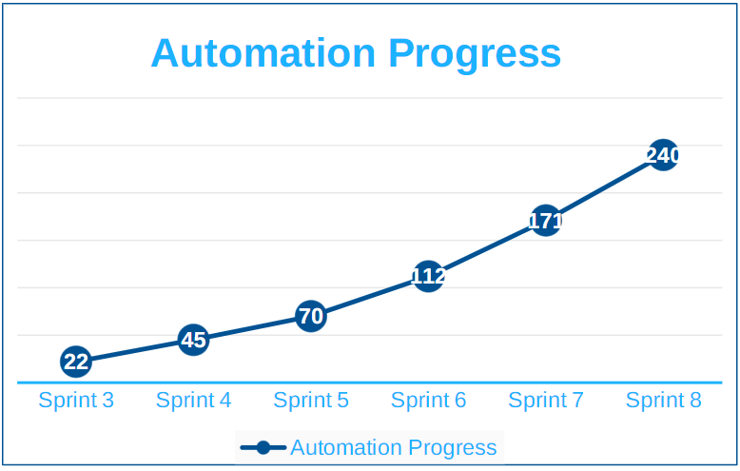
Sample Progress reports – KPI reports, Progress charts
Deepak to vet
KPI No. | Description | Required Performance Threshold * | Catastrophic Failure Threshold * | Measurement Period | AAT8- Nitro | AAT10- EBC | AAT4-GE | AAT11-Resconnect
1 | Defect leakage into Customer Test phases per Agile team | 5% or less | 7.5% or more | Monthly | 0% | 0% | 0% | 0%
2 | Automated Regression Testing | 95% or more | 90% or less | Monthly | 100% | 100% | 0% | 100%
3 | Sustained velocity of per Agile Team | 85% or more | 80% or less | Monthly | Last 6 Sprints: 30.38 SP Average 14.3,14.4: 23 SP Actual: 75.72 % | Last 6 Sprints: 48.25 SP Average 14.3,14.4: 45.50 SP Actual: 94% | Last 6 Sprints: 16SP Average 14.3,14.4: 22.50 SP Actual: 80% | Last 6 Sprints: 53.75 SP Average 14.3/14.4 : 55.50 SP Actual: 103%
4 | Predictability | 90% or more | 80% or less | Quarterly | PI 14 : 31.25 SP 107.14% | PI-14 : 48.75 SP 102.99% | PI-14 : 15.25 SP 81.70% | PI 14: 62.75 SP 120.67 %
5 | Service Report submission | 100% | 98% or less | Monthly | 100% | 100% | 100% | 100%
6 | Jira | No exceptions |  | On Going | 100% | 100% | 100% | 100%
7 | Confluence | No exceptions |  | On Going | 100% | 100% | 100% | 100%
8 | ODC Staff Attrition | 15% or less | 18% or more on an annualised basis | Quarterly | 2% | 0.06% | 0.06% | 0.06%
9 | Commitment Index | >=85% | <=75% | Monthly | 85% | 86% | NA- Weblogic Migration | 88.03%

Slide 69
Project status Reporting
Monthly Service Reports
RCA Reports
Proactive alerts
KPI Reports
Monthly capacity reports and Recommendations

Slide 70
Implementation Plan and Team Structure (Deepak)
Provide implementation plans and proficiently integrate, configure and provision the solution into Emirates Group’s environment based on an SDLC highlighting the various stages or continuous cycles required for requirement analysis, Solution design, , implementation, testing and all relevant content and data migration​
Provide the methodology and tools used to track the progress of the project

Slide 71
Risk Management Plan
Provide the risk management plan and manage the risks to the implementation with the appropriate mitigation and response plan

Slide 72
Sample Risk Register…
Risk | Impact 1-3 | Likelihood 1-3 | Risk Score 1-9 | Mitigation
Availability of key stakeholders and EK SMEs to help drive transformation | High (3) | Likely (3) | High (9) | Need to ensure that time required from individuals is communicated well in advance to the required stakeholders
Lack of clear requirements | High (3) | Unlikely (1) | Low (3) | Workshops with required business owners and teams to clearly define and document the requirements and use cases. Use of continuous feedback sessions where team’s playback their understanding of requirements.
Access to relevant data used to validate understanding & priorities | Medium (2) | Unlikely (1) | Low (2) | Define data requirements before start of program and then work with EK teams to get all collections scheduled in advance
Delay in providing access to required systems | Medium (2) | Possible (2) | Medium (6) | Plan all access requirements before the start date of engagement to ensure minimal delay to project
Lack of communication related to transformation journey | High (3) | Unlikely (1) | Low (3) | Governance model will encompass critical communication at all levels to create awareness and excitement. Also make sure that change management a key activity
Lack of focus on governance | High (3) | Unlikely (1) | Low (3) | Ensure governance schedule set up and all parties engaged.
Scope Creep | High (3) | Possible (2) | Medium (6) | Put in place change control process governed by the Steerco.
Risk Score: 1-3 LOW, 4-6 MEDIUM, 9 HIGH)
Notes:
We identify, rate and then determine how to mitigate risks so that they do not become issues.
A key element of the kick-off phase will be to review all catalogued risks, to ensure that the group has put in place strong processes for ensuring that the appropriate mitigation is in place.
The register will be reviewed at the weekly review and monthly steerco to ensure (1) all risks captured, (2) that new risks incorporated and (3) that mitigation in place to ensure risks do not become issues. Shown below is a sample of the risks that Coforge expects to encounter, It is indicative only.

Slide 73
Stages of Implementation
Align the phases or stages of implementation with best practice change management process to introduce a system of this scale globally

Slide 74

Technical Support and Maintenance
To be discussed and finalized with teams
Coforge proposes our the below model for technical support and maintenance.
This model encompasses ITIL v3 best practices and conforms to ISO 20000 standard.
Service Support Hub
Key Highlights
L1 and L2 support will be provided by Coforge and L3 & L4 by the product supplier. Coforge will own the coordination with the product vendor
Three months warranty support post Go Live will be included covering all the support & maintenance activities
Coforge will initiate the training during the UAT phase and it will be completed during the warranty phase.
Application and product training will help EK admin users to understand the application and enable them to handle the contents / data / workflows management independently.
Coforge recommends to have the yearly proactive compliance checks like security, usability, accessibility and performance.
DevOps process will be aligned with EK processes
ServiceNow will be used for defect logging
Operational Reports covered
Monthly - Backlog report, changes reports
Annual– Proactive compliance reports and health check reports
Support Helpdesk
Application Helpdesk (Onsite?)
Remote Support Team
L1 Support
L3 Support
L2 Support
L4 Support
Regular Tests & Updates
Performance checks
Preventive Maintenance
Security and Penetration Tests
Compliance checks
Patches, upgrades
Quality Assurance: Verification & Validation and Proactive checks
DevOps Aligned with Emirates’ methodologies
Automation Led Empowerment
Audit & Reports
Backlog Report
Changes Report
Security Audit Reports
Annual Health Check Reports

Slide 75
Agenda
01.
02.
03.
04.
05.
06.
07.
08.
09.
Executive Summary
Management Profile
Proposed Solution
Requirement Response
Project Management
Assumption & Dependencies
Training
Appendix B (Sub-Contractor Profile)
Appendix (About Coforge)

Slide 76
Technical Assumptions (All Service Lines)
Data Migration has not been considered in current scope. However, we have estimated efforts for integration of data from the EK systems

Slide 77
Agenda
01.
02.
03.
04.
05.
06.
07.
08.
09.
Executive Summary
Management Profile
Proposed Solution
Requirement Response
Project Management
Assumption & Dependencies
Training
Appendix B (Sub-Contractor Profile)
Appendix (About Coforge)

Slide 78
Training Approach (Deepak)

Slide 79
Agenda
01.
02.
03.
04.
05.
06.
07.
08.
09.
Executive Summary
Management Profile
Proposed Solution
Requirement Response
Project Management
Assumption & Dependencies
Training
Appendix B (Sub-Contractor Profile)
Appendix (About Coforge)

Slide 80
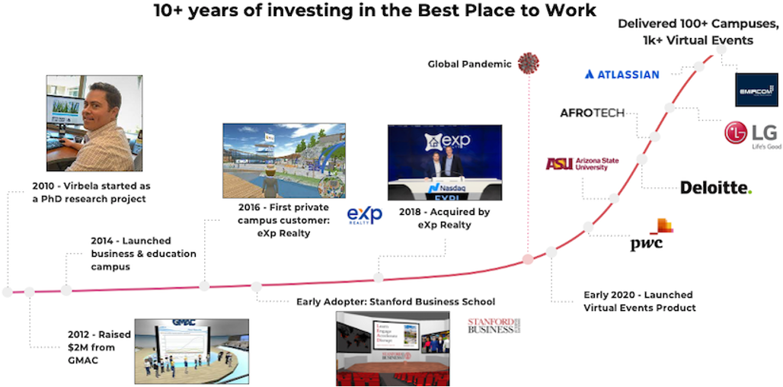
Sub Contractor Profile
Virbela (Nasdaq: EXPI) builds engaging virtual worlds for remote work, learning, and events. Founded in 2012 by a team of behavioral psychologists, Virbela’s mission is to help organizations and people thrive in a remote-first future.

Slide 81
Core Competencies

Slide 82
Agenda
01.
02.
03.
04.
05.
06.
07.
08.
09.
Executive Summary
Management Profile
Proposed Solution
Requirement Response
Project Management
Assumption & Dependencies
Training
Appendix B (Sub-Contractor Profile)
Appendix (About Coforge)

Slide 83
About Coforge
Company Profile
Contact Information

Slide 84
Let’s engage!

